Slide 1
CO3 – FLEXIBLE ELECTRONIC MATERIALS
CONJUGATED POLYMERS
MOLECULAR ELECTRONICS
DR. S. SUSITHRA
DEPARTMENT OF CHEMISTRY
PSG COLLEGE OF TECHNOLOGY

Slide 2
Syllabus
FLEXIBLE ELECTRONIC MATERIALS: Conjugated polymers – electronic energy bands - mechanism of charge transport – intrachain and interchain - solitons, polarons and bipolarons. Factors influencing charge transport – structural features - defects, molecular weight, crystalline/amorphous nature, doping- oxidative and reductive. Synthesis, properties and applications of polyaniline, polythiophene and polypyrrole. Molecular electronics - graphene, fullerenes, carbon nanotubes – structure, synthesis, properties and applications.

Slide 3
Course plan
Introduction to conducting polymers: structural features electronic energy bands mechanism of charge transport – intrachain and interchain - solitons, polarons and bipolarons. Factors influencing charge transport – structural features - defects, molecular weight, crystalline/amorphous nature, doping- oxidative and reductive – energy bands.
Conducting polymers- synthesis, properties and applications. Oxidative polymerisation – electrochemical and chemical synthesis of Polypyrrole, polythiophene and polyaniline. Properties Applications of conducting polymers
Molecular electronics graphene, fullerenes, carbon nanotubes – structure, synthesis, properties and applications.

Slide 4
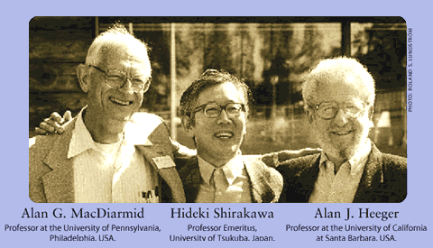
Conducting polymers
The Nobel Prize in Chemistry 2000 was awarded jointly to Alan J. Heeger, Alan G. MacDiarmid and Hideki Shirakawa,
"for the discovery and development of conductive polymers"

Slide 5
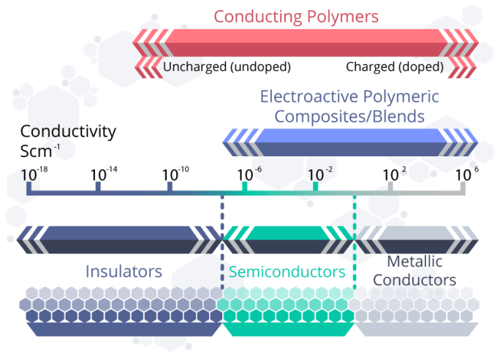
Conducting polymers
Conductive polymers (CP) are a distinctive group of organic materials that exhibit the electrical and optical properties of both metals and semiconductors

Slide 6
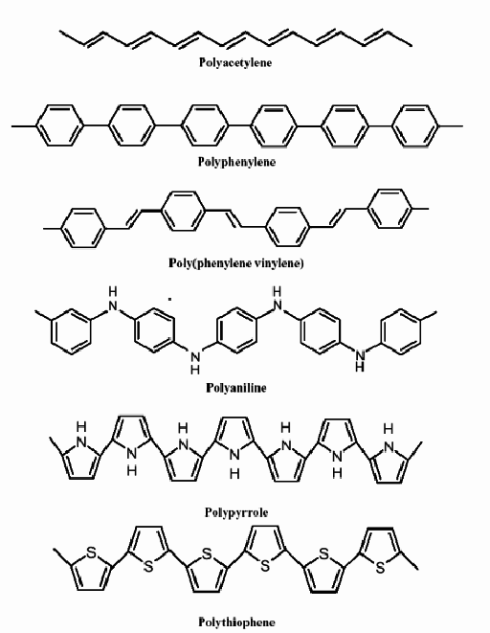
Conducting polymers
Intrinsic conducting polymer
Polymer containing conjugated
π – bond in the main chain.
Organic semiconductors
Extended delocalized electrons.

Slide 7
Conducting polymers
Doped conducting polymer
Polymer main chain is disrupted either by addition or removal of electron.
Process is called doping.
There are two types of doping:
1 - oxidation with halogen (or p-doping).
2 - Reduction with alkali metal (called n-doping).

Slide 8
Conducting polymers - conditions
The first condition is that the polymer consists conjugated double bonds. Longer the extensión, more is conductivity.
The second condition is that the electrical conductivity is increased by adding a dopant, by which the polymer main chain is disturbed.

Slide 9
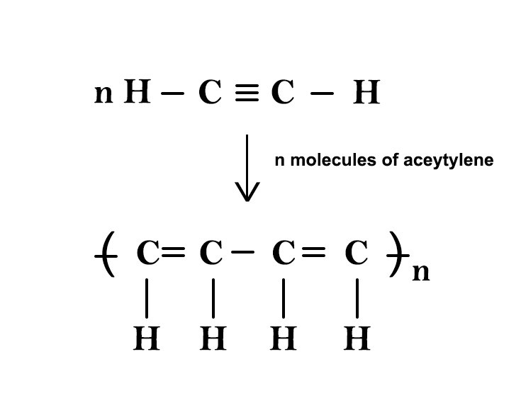
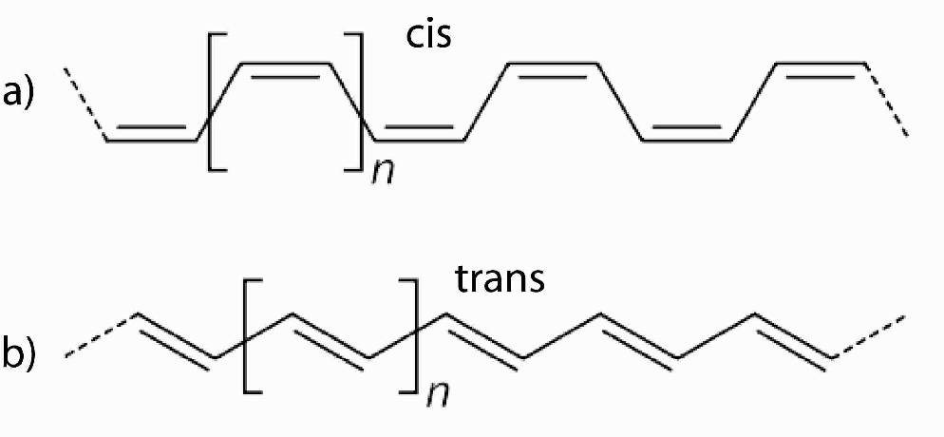
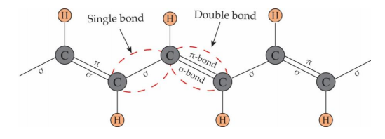
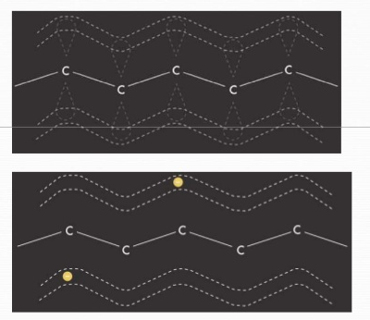
Conduction Mechanism in CPs
Polyacetylene (PAc) (CH)_{n}
Carbon atom is sp² hybridized with one p_{z} orbital is unhybridized, which is non-bonding.
Localized electrons in sigma bond form polymer backbone and contribute to the mechanical property of polymers.
Electrons in the π-bonds are delocalized along the chain and responsible for the electrical and optical properties of CPs.
Conductivity
Undoped polyacetylene: ~ 10⁻⁹ (cis) and 10⁻⁵ (trans) S cm⁻¹
Doped polyacetylene : High electrical conductivity (10² to 10⁵ S cm⁻¹

Slide 10
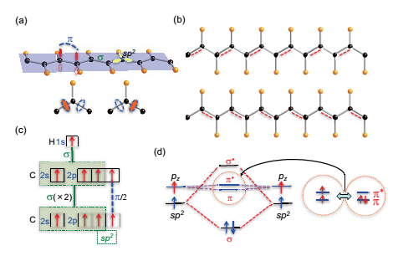
Crystal structure of 1D trans-polyacetylene (CH)_{n}. Two σ -bonds form among two neighboring C–C via sp² hybridized orbital with unhybridized p_{z} orbital overlap to form π and a third σ -bond forms with H.
Two degenerate configurations of PAc.
Sp² hybridization model proposed for 1D trans-PAc.
The molecular orbital energy diagram for the σ- and π-bonding relationship.

Slide 11
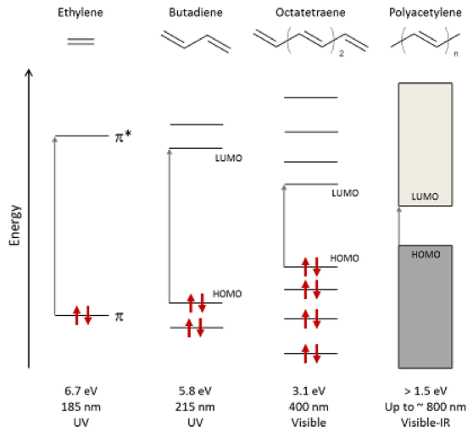
Electronic Structure and Energy bands
Schematic of energy-level splitting and absorption in alkenes with increasing conjugation length, highlighting the lowest-energy optical transitions from HOMO to LUMO. The bandgap of polyacetylene depends on both the number of monomers n and the effective conjugation length in the polymer. Arrows represent spin-paired electrons.

Slide 12
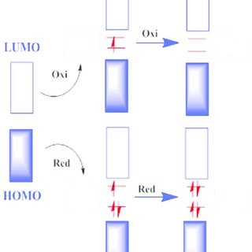
Electronic Structure and Energy bands
Doped CPs
Oxidation type doping (p-type)
Electron is removed directly from the HOMO or valence band of the polymer and moves to the dopant species. Thus, creates a hole in the polymer backbone.
(b) Reduction type doping (n-type)
Electron is transferred to the LUMO or conduction band of the polymer from the dopant species. Thus electron density is increased

Slide 13
Charge transport carriers
The oxidation / reduction process creates charge carriers in the form of polarons (radical ions), bipolarons (dications or dianions) or solitons in the polymers.
CPs can be categorized into degenerate and non-degenerate systems based on their band structures in the ground state.
Degenerate polymers possess two identical geometric structures in the ground state.
Non-degenerate polymers exhibit two different structures with different energies in the ground state (eg. Benzenoid and Quinonoid structures of benzene).
Solitons are known to be the charge carriers in degenerate CPs, like PAc.
Polarons and Bipolarons serve as the charge carriers in both degenerate and non-degenerate CPs, like PPy and PT.
The movement of these charge carriers along polymer chains produces conductivity.

Slide 14
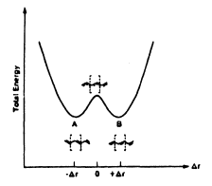
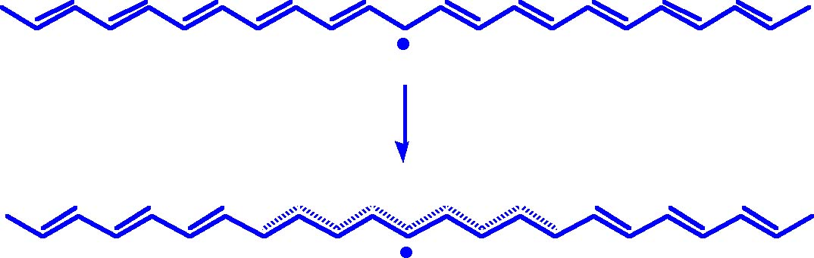
Charge transport carriers
Soliton
Soliton is where a single electron occupies a 2p_{z} unhybridized (non-bonding) orbital of a sp² hybrid carbon atom. It is a defect in which the change in bond alternation is extended over 5 to 9 repeating units.
Soliton has ½ spin with zero charge, which can move along the chain with a distortion.
The non-bondingorbital corresponds to a soliton level at the middle of forbidden gap. It may contain zero, one or two electrons.
Addition or removal of one electron to the neutral state corresponds to a negative or positive soliton with zero spin.
Soliton is a charge carrier in the degenerate conjugated polymer system.

Slide 15
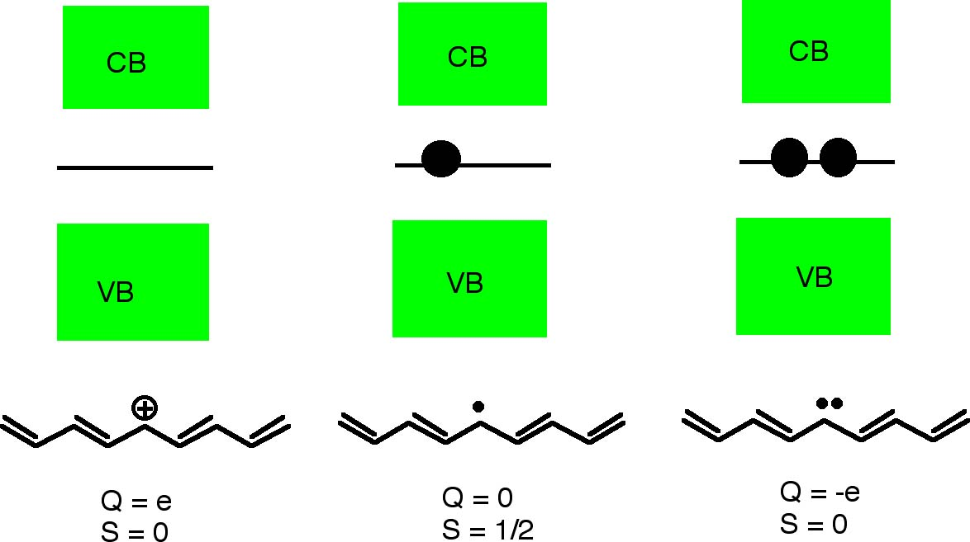
Positively charged
Soliton S⁺
Neutral soliton S⁰
Negatively charged
Soliton S⁻

Slide 16
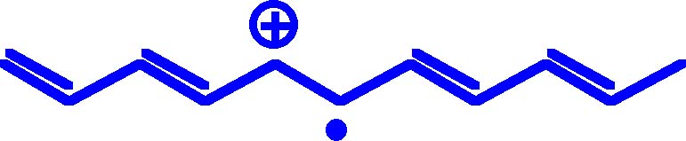
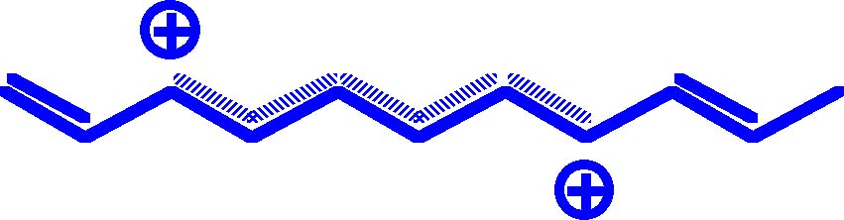
Polaron and Bipolaron
In a degenerate polymer system, isolated solitons are not stable in polymers, charge exchange will lead to the formation of S⁰-S⁺ (or S⁰-S⁻) pairs, which will be strongly localized to form a polaron
Q = +e
S = 0
Polaron is mobile along the polymer chain
Two polarons may collapse to form a bipolaron, which has zero spin but with charges
Q = +2e
S = 0
The two positive charges of bipolaron are not independent, but move as a pair.
The spins of the bipolarons sum to S = 0.

Slide 17
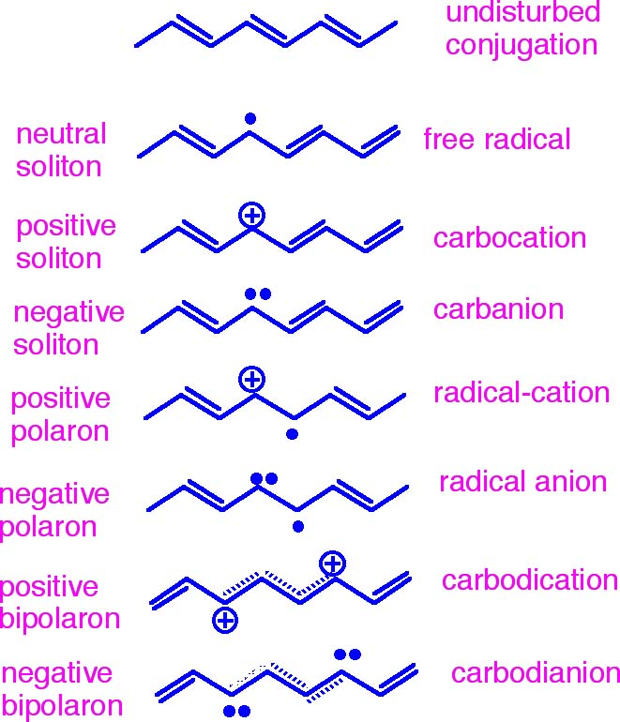
In chemical terms:

Slide 18
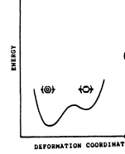

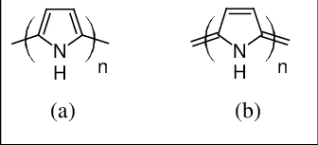
Polaron and Bipolaron
In the case of a non degenerate ground state, the energies of the two chains on either side of the defect are different. Therefore, a single bond alternation defect in such a chain cannot behave as a charged soliton.
A charge injected on a chain is accompanied by a distortion in the chain and forms a polaron.
The removal of an electron from a polymeric system creates a free radical and a positive charge. The radical cation is then coupled by a local bond rearrangement and a quinoid-like bond sequence is formed.
Since the lattice energy of quinoid is higher, when compared to benzenoid, these distortions are limited. In the case of PPy, the lattice distortion is believed to extend over about four pyrrole rings. This combination of charged site coupled with a free radical via a local lattice distortion is called a polaron.
A polaron may be a radical cation (oxidation) or a radical anion (reduction). Like a free carrier, a polaron has a spin of 1/2 and a charge of ±e.

Slide 19
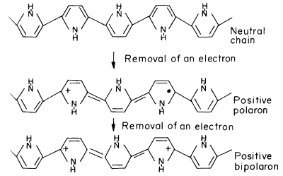
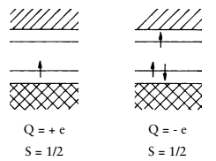
Polaron and Bipolaron
Polaron formation creates new localised electronic states in the band gap. Polaron states of PPy are symmetrically located about 0.5 eV from the band edges.
In many cases, it has been found that the conductivity of the system is spinless, which suggests that charge carriers other than polarons would be appropriate in these cases.
Therefore, it was proposed that polaron interaction would produce a new charge carrier with no spin and 2e charge corresponding to a positive bipolaron.
Energy levels and localised states for
(a) positive and (b) negative polarons

Slide 20
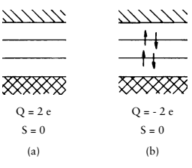
When a polymeric chain having a polaron is subjected to further oxidation, an electron is removed from either the polaron or rest of the chain. Since, the formation of a bipolaron causes further decrease in ionisation, its formation is thermodynamically more favourable. Bipolaron energies are lower than those of polarons by 0.4 eV.
Bipolaron states are located symmetrically within the band gap, about 0.75 eV away from the band edges in case of PPy. Continuous doping of the polymer creates additional localised bipolaron states, which overlap to form continuous bipolaron bands.
During doping, the bipolaron bands tend to merge with the conduction band (CB) and valence band (VB), resulting in metal-like conductivity.
Energy levels and occupied localised states for
(a) positive and (b) negative bipolaron

Slide 21
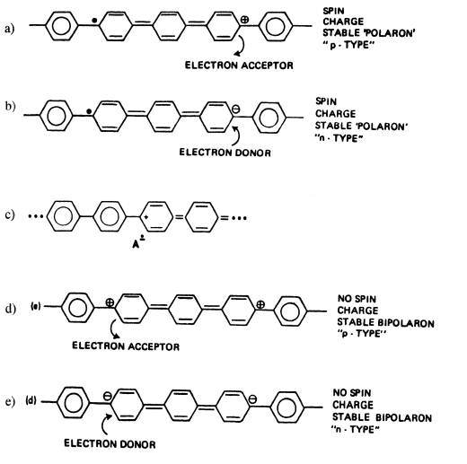
Structures of polarons/bipolarons in Poly(p-phenylene)

Slide 22
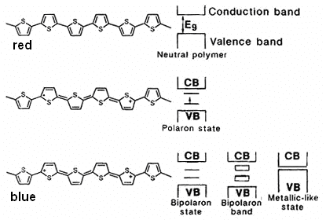
Structures of polarons/bipolarons in Poly(thiophene)

Slide 23
Charge transport mechanism
Intra-chain transport:
The conductivity in a CP or the charge transport can occur by migration of electrons or holes along the backbone chain, called as intra-chain transport.

Slide 24
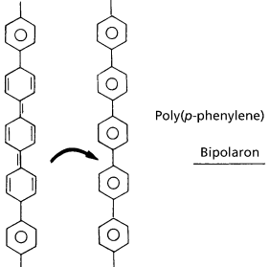
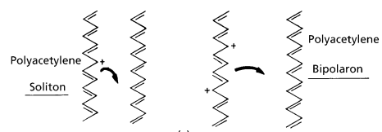
Inter-chain transport:
The charge carriers, soliton, polaron and bipolaron can be transferred from one polymer chain to another chain through redox reactions between neighboring chains. This process is favorable if the neighboring polymer chains are properly aligned with each other.

Slide 25
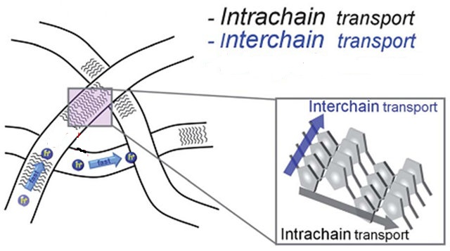
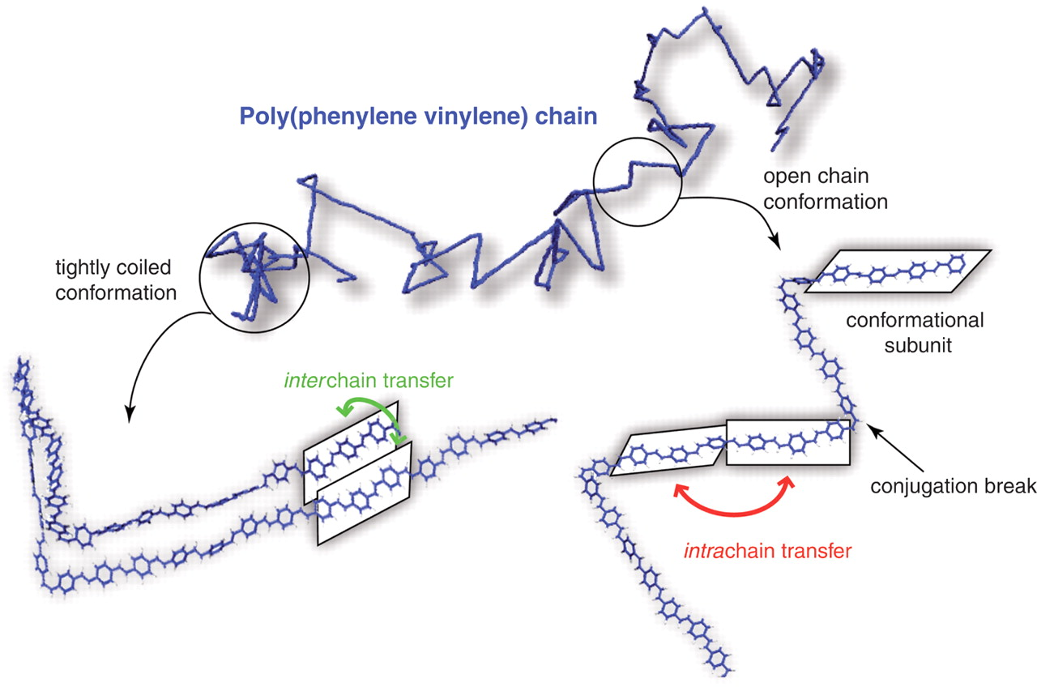
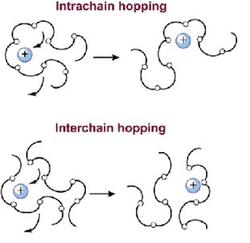
Intra and Inter-chain transport

Slide 26
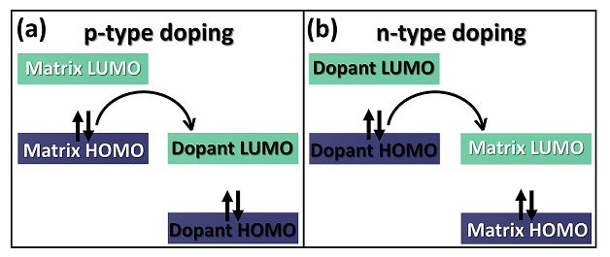
Doping in conducting polymer
The conductivity of intrinsic CPs can be enhanced by doping.
Doping of CPs can be accomplished chemically (i.e. exposure to solution or vapour of dopant) or electrochemically.
Chemical oxidants (p-type): Iodine, Nitronium species, transition metal salts, AsF₅
Chemical reducing agents (n-type): Na, K, Li - naphthamide
Electrochemical method: ClO₄⁻ and BF₄⁻
In p-type doping, the molecular dopant acts as the electron acceptor, and the EA of dopant is equal to or higher than the IE of the organic matrix.
In n-type doping, the molecular dopant acts as the electron donor, and the EA of the organic matrix is equal to or higher than the IE of dopant.

Slide 27
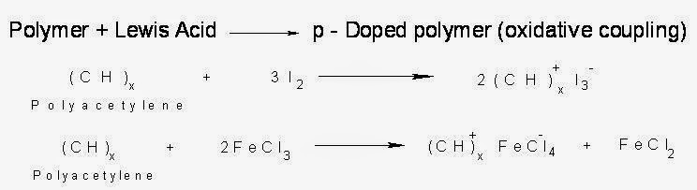
Chemical doping
1. Oxidative (p-type) doping
CPs treated with electron-deficient species (Lewis Acids) like FeCl3 or I2 vapour or I2 in CCl4, CPs will oxidizes and a positive charge is created in the polymer chain.
Removal of one electron from the pi-backbone of a CP forms a radical cation (polaron), which on losing another electron forms bipolaron. The delocalization of positive charge causes electrical conduction.

Slide 28
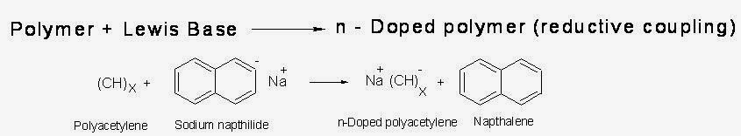
2. Reductive (n-type) doping
CPs treated with electron-rich species (Lewis Bases), CPs will reduce and a negative charge is created in the polymer chain.
Addition of one electron to the pi-backbone of a CP forms a radical anion (polaron), which on adding another electron forms bipolaron. The delocalization of negative charge causes electrical conduction.

Slide 29
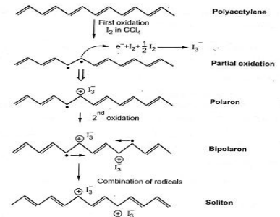

Slide 30
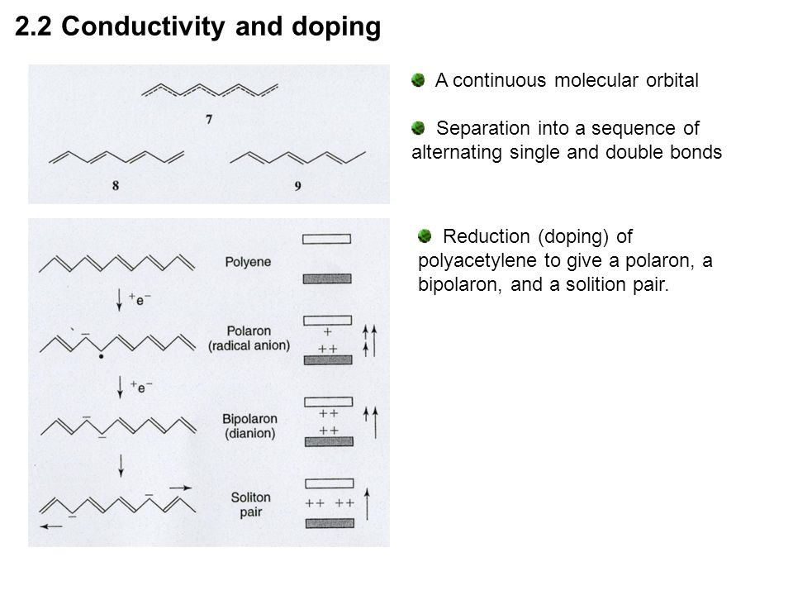
Na⁺
Na⁺
Na⁺
Na⁺
Na⁺
Na⁺
Na⁺

Slide 31
Methods of doping
1. Gaseous doping
Polymers are exposed to vapours of doping agent inside a closed chambers, where temperature and pressure are maintained at optimal levels.
Eg. I2 vapours, AsF5 vaopur are used as doping agents
The time required for optimum doping even at room temperature and pressure is very low within the range of 10 minutes.
2. Solution doping
The dopant and all the products of the dopants are dissolved in a solvent in which the polymer is insoluble. The undoped CP in the form of powder or film is then dipped in the solution of dopant.
Eg. PAc is dipped in a liquid solution in naphthalene or liquid sodium amalgam.

Slide 32

Electrochemical doping
Doping after polymerization
Electrochemical doping is done by electrochemical oxidation or reduction of CP on an electrode.
For electrochemical p-doping, the conjugated polymer main chain is oxidized to lose an electron (gain a hole) accompanying the doping of counter-anions from electrolyte solution:
where, A⁻ denotes the solution anion,
CP⁺(A⁻) represents CP with the main chain oxidized and counter-anion doped.
For electrochemical n-doping, the conjugated polymer main chain is reduced to gain an electron accompanying the doping of counter-cations from electrolyte solution:

Slide 33
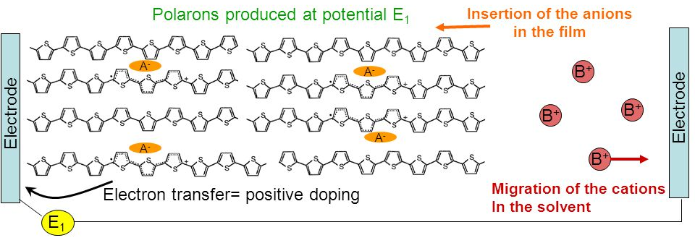
In electrochemical doping, the electrode supplies the redox charge (either by donating or removing electrons) to the conjugated polymer.
An electrolyte containing the counter-ion required for maintaining electrical neutrality in the doped polymer is taken.
The amount of charge used up in the electrochemical process determines the degree of doping.

Slide 34
Electrochemical doping
Electrochemical polymerization before doping
Conducting heterocyclic polymers such as polypyrrole, polythiophene, polyfuran and their derivatives can be obtained in a single step from their monomers by electrochemical polymerization and simultaneous doping with the dopant. Polymers thus obtained are purer and homogeneous. The mechanism of electrochemical polymerization involves various steps which are as follows:
(1) Oxidation of monomer to a radical cation.
(2) Dimerization of radical cations followed by a proton loss to yield a neutral dimer. (3) Oxidation of dimer to its radical cation.
(4) Reaction of dimer radical cation with another radical cation

Slide 35
Factors affecting charge transport or conductivity
of conducting polymer
A CP in its undoped, i.e. neutral state, is generally termed pristine (or, virgin).
Conjugation length:
The conjugation length of polymer chain is important for its high electrical conductivity, and not its chain length.
The conjugation length of a polymer chain is the average distance between two defects that interrupt the conjugation
Conductivity decreases rapidly with decreasing conjugation length.
(ii) Doping level:
The extent of oxidation/reduction, i.e. doping, is called doping level, and is measured as the proportion of dopant ions or molecules incorporated per monomer unit.
The doping level of the polymer is determined by dopant concentration expressed in mol %.
For instance, a CP with one dopant ion per four monomer units, would have a doping level of 0.25 mol or 25 mol %. Conductivity increases with increase in doping level of polymers.

Slide 36
(iii) Temperature:
Temperature dependence of conductivity is understood by defining two conductivity regimes:
• The high conductivity regime with conductivity >1000 S cm⁻¹
• The moderate and low conductivity regime with conductivity <100 S cm⁻¹.
Conductivity generally decreases with decrease of temperature.
This temperature dependence of conductivity varies according to two factors:
1) Type of Conductivity System:
Moderate & low conductivity systems - Conductivity vanishes as T 0.
High conductivity systems - Conductivity remains finite
2) Level of Doping
Low Doped Sample: Temperature dependence of conductivity is very drastic.
High Doped Sample: Conductivity is nearly temperature independent. Reason:
With increase in temperature, there is higher thermal excitation, which causes more electrons to be released from their inter-atomic bonds. The applied field releases more no. of electrons, giving rise to increased conductivity with rise in temperature.

Slide 37
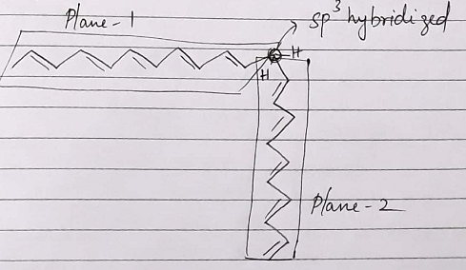
(iv) Mobility of charge carriers:
The mobility of charge carriers in CPs, is much lower compound to those in inorganic semiconductors. Conductivity of CP is given by,
 = μ_{e} + μ_{h}
μ_{e} = mobility of electrons
μ_{h} = mobility of holes
The two factors which affect the mobility of charge carriers in CPs are disorder in the polymer chain and crystallinity of the polymer.
Disorder:
1. sp3 defect:

Slide 38
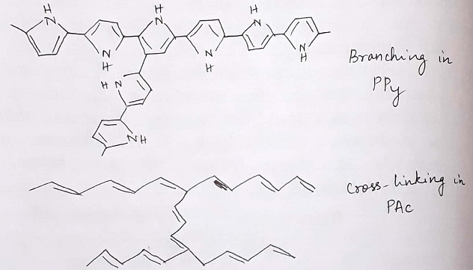
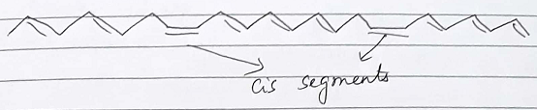
2. Branching of the chains and cross-linking
3. cis-trans segments in same chain:

Slide 39
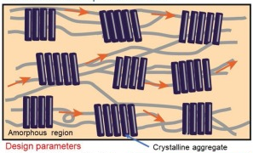
(b) Crystallinity:
The ordered packing in the crystalline regions produces a high degree of local chain orientation which is likely to result in higher conductivity.
The dense chain also reduces the energy required for inter-chain charge transport, also contributed to the increase in conductivity.
Crystallinity increases, the mobility or charge transport increases
Molecular weight and crystallinity
The lower molecular weight chains would be expected to crystallize to a greater extend than those of higher molecular weight. Therefore, the low molecular weight CPs have greater mobility and conductivity.
Note: For CPs used in LED applications, the separation between polymer chains is added by introducing bulky side groups and thus making the polymer more amorphous is beneficial. This is because inter-chain hopping of charges decreases the power efficiency of the LED.

Slide 40
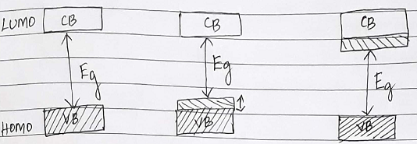
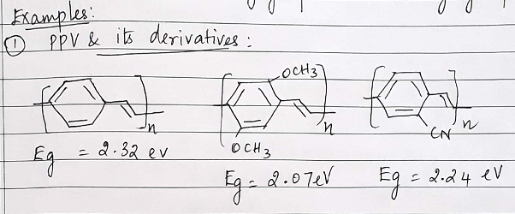
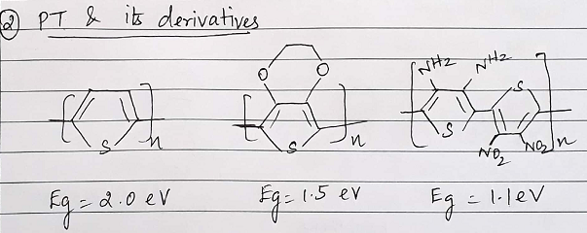
(v) Effect of substituents on conductivity of CPs
Polymer
Polymer with e⁻ withdrawing groups
Polymer with e⁻ donating groups

Slide 41
Molecular Designing of Low Band-Gap Electrically Conducting Polymers
The process of doping of electrically conducting polymers is often the source of chemical instability in them. Another problem often associated with doped polymers is their poor processibility which is restricted to a great extent because of the insolubility and infusibility of these polymers. The possible elimination of doping in preparing conducting polymers while still achieving high conductivity is one of the original motivations for need of small band-gap polymers. Band Structure Engineering of novel polymers with low band-gaps
To be successful in designing low band-gap polymers, it is necessary to have a complete understanding of the relationship between the chemical structure of the polymer and its electronic properties (such as ionization potential (IP), electron affinity (EA) and band-gap (Eg)) which determines its conduction properties. The band structure can be tuned by altering either or both the electronic structure and stearics of the backbone. The first low band-gap CP reported was poly (isothianaphthene) (PITN) (Eg = 1.0-1.2 eV). This has been attributed to the ability of the fused benzene ring to stabilize the quinoidal form of the polymer in the conductive state.

Slide 42
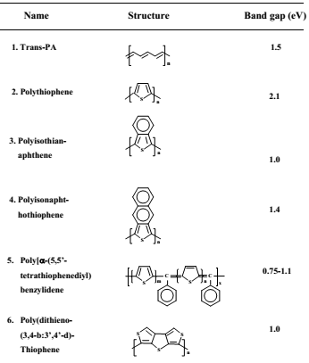
Some low band gap conjugated polymers

Slide 43
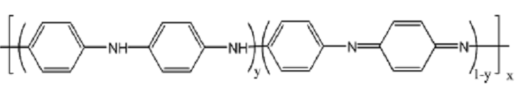
Polyaniline (PANI)
Properties
➢ Easy synthesis.
➢ It is the only conducting polymer whose electronic structure and electrical properties can reversibly be controlled by both oxidation and protonation.
➢ It has interesting electrochemical behaviour.
➢ It shows environment stability.
➢ Ease of non-redox doping by protonic acids.
General structure of Polyaniline:
Polyaniline, a typical phenylene based polymer, has a chemically flexible –NH– group in the polymer chain flanked by phenyl rings on either sides.
The diversity in physicochemical properties of PANI is traced to –NH– group.
Out of several possible oxidation states, 50 % oxidized emeraldine salt state shows electrical conductivity.

Slide 44
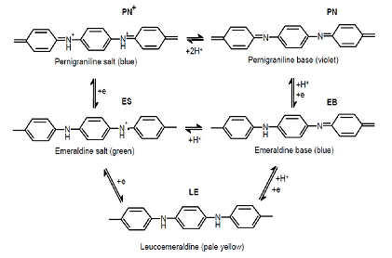
Interconversion of different oxidation states of PANI
Fully reduced state, leucoemeraldine form where, y = 1.
Half oxidized state called emeraldine form where y = 0.5, i.e., it has amine (–NH) and imine (=N) sites in equal proportions.
Fully oxidized state called pernigraniline state, where y = 0.

Slide 45
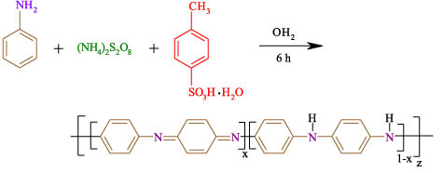
Synthesis of PANI
Synthesis of PANI involves oxidative polymerization, in which the polymerization and doping occurs at the same time, and may be accomplished either electrochemically or chemically. Electrochemical methods tend to have lower yields than chemical yields.
Chemical Synthesis (Oxidative polymerization):
Synthesis of PANI by chemical oxidation way involves the use of either hydrochloric or sulfuric acid in the presence of ammonium persulfate as the oxidizing agent in the aqueous medium.

Slide 46
Electrochemical synthesis:
The electrochemical synthesis of conducting polymer is an electro-organic process rather than an organic electrochemical one, because the more emphasis is on the electrochemistry and electrochemical process rather than on organic synthesis.
In most of the applications, it is essential to synthesize polymers into a thin film of well defined structure, preferably with a large area. For preparation of such films, electrochemical synthesis is a standard method.
CP are synthesized in the form of films adhering to the electrode, so that a study of the optical and electrical properties can be carried out in-situ by using electroanalytical techniques.
The electrochemical synthesis of conducting polymers is similar to the electrodeposition of metals from an electrolyte bath; the polymer is deposited on the electrode surface and also in the in-situ doped form.

Slide 47
Three electrochemical methods can be used to PANI synthesis
a) Galvanostatic method when applied a constant current, b) Potentiostatic method with a constant potential, c) Potentiodynamic method where current and potential varies with time.
A three-electrode assembly composes the reactor vessel: A working electrode on which the polymer is deposited,
A counter electrode also named auxiliary electrode (platinum grid)
A reference electrode (in most cases, a saturated calomel electrode (SCE)
The more common working electrode is a platinum one, but PANI depositions have also been realized onto conducting glass (glass covered by indium-doped tin oxide (ITO) electrode), Fe, Cu, Au, graphite, stainless steel, etc.
PANI can be then peeled off from the electrode surface by immersion in an acidic solution.

Slide 48

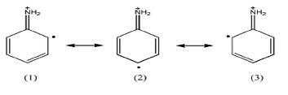
Polymerization mechanism of PANI
1. Oxidation of aniline: Monomer radical cation formation
Three resonance forms of aniline radical cation

Slide 49
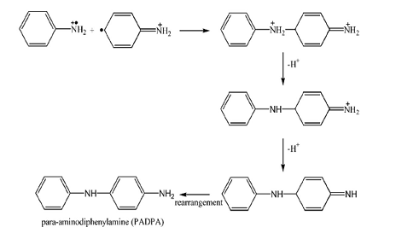

2. Dimer formation: Coupling of aniline radical cation
Head to tail coupling

Slide 50
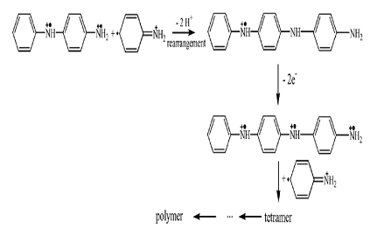
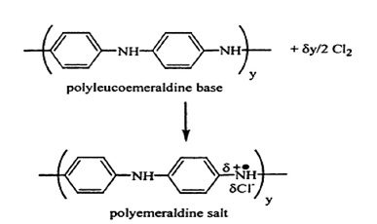
3. Dimer radical cation reacts with radical cation monomer or with dimer radical cation to form trimer or tetramer.
4. Oxidation/doping of polymer

Slide 51
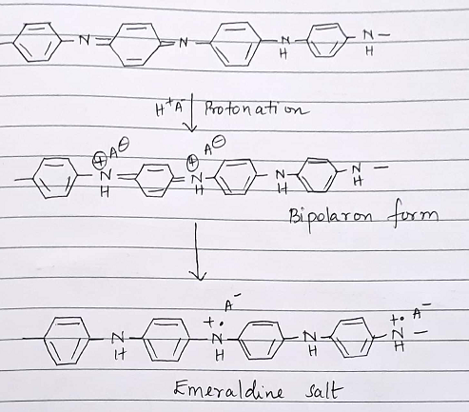
Conductivity of PANI

Slide 52


Synthesis of polythiophene / polypyrrole

Slide 53

Applications of conducting polymers

Slide 54
Applications of conducting polymers
Conducting polymers are widely used :
1. In rechargable batteries. 2. In making analytical sensors for pH, O2, SO2, NH3, glucose, etc. 3. In the preparation of ion exchangers. 4. In controlled release of drugs. 5. In optical filters. 6. In photo voltaic devices. 7. In telecommunication systems. 8. In micro-electronic devices. 9. In bio-medical applications.

